Slide 1
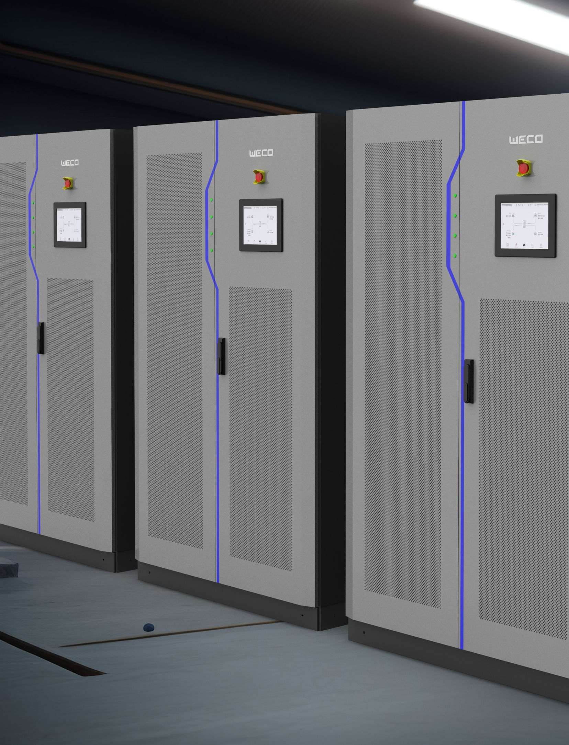
HYBO CABINET INVERTERS
INDOOR FAMILY
Innovative Hybrid Inverters for BESS Applications On and Off-Grid
100 kW – 500 kW
WeCo Brand and logo are registered by WeCo Srl Italia

Slide 2
TL x10 SCALABILITY
HYBO TL PCS
Single Door
Scalable Up To :
3 MW PCS
HYBO TL HYBRID
Single Door
Scalable Up To:
1.2 MW PCS / 1.2MW PV
1.2 MW PCS / 1.8 MW PV
HYBO TL HYBRID
Dual Door
Scalable Up To:
2.4 MW PV / 2.4 MW PCS
CS~TS x4 SCALABILITY
HYBO TS PCS
Dual Door
Scalable Up To:
2.4 MW PCS
HYBO CS HYBRID
Dual Door
Scalable Up To:
2 MW PCS / 2.9 MW PCS
wecobatteries.com

Slide 3
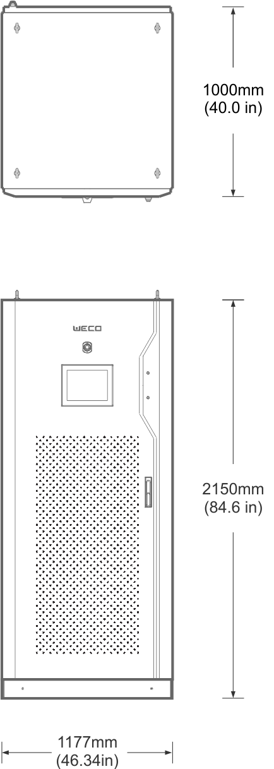
HYBO TL PCS
TRANSFORMERLESS PCS INVERTER
Specifications
120 | 180 | 240 | 300
BATTERY
AC SIDE
BACKUP EPS (OPTIONAL)
SYSTEM
ENVIRONMENT
INTERFACE
OTHERS
Min. Battery Voltage | 680 V
Min. Number Of Batteries In Series | 15 Battery Modules
Max. Battery Voltage | 1000 V
Max. Number Of Batteries In Series | 17 Battery Modules
Battery Input Channels | 4
Max. Charging / Discharging Power | 120 kW | 180 kW | 240 kW | 300 kW
Grid Type | 3L + N + GND
Rated Power AC Side | 120 kW | 180 kW | 240 kW | 300 kW
Rated Current AC Side | 172 A | 258 A | 344 A | 430 A
AC Breakers And Interruption Capacity | 250 A / 70 kA | 315 A / 70 kA | 400 A / 70 kA | 500 A / 70 kA
Rated Voltage | 400 Vac
Voltage Range | 400 Vac ± 15 %
Rated Frequency (Hz) | 50 Hz / 60 Hz
Frequency Range | ± 3 Hz
Power Factor (Off Grid) | -0.8 ~ +0.8
Frequency Accuracy | 0.2 Hz
Voltage Ripple | < 3 %
Current Ripple | < 2 %
Output Harmonic Wave | < 3 %
Phase Unbalance Load (Off-Grid W/STS Only) | 100%
STS For EPS (EPS Load Support) | Optional Accessory |  |  | N/A
STS Switch Time ON To Off Grid | 20 ms (Linear Load)
STS Switch Time OFF To ON Grid | 30 ms
EPS Overload Support | 0%
EPS Max. Power (Only With STS Installed) | 100%
EPS Critical Load Support | EPS Output Can Support Individually Connected Loads Under Each Inverter
EPS Output AC Breaker Interruption Capacity | 250 A / 70k A | 315 A / 70 kA | 400 A / 70 kA | N/A
Reaction Time To External Commands | 200 ms
Switch Time From Charge To Discharge | 20 ms
Switch Time From Discharge To Charge | 20 ms
System Start Up Capability Off-Grid | OFF Grid + Battery = Operation Granted |  |  | N/A
Emergency Stop Intervention | 600 ms
IP Rating | IP20
Working Temperature | -20 °C ~ +55 °C (Over 45 °C Derating)
Humidity | 0 % RH ~ 95 % RH, Non-condensing
Working Altitude | At 45 °C, 2000 m (No Derating), 2000 m ~ 4000 m Derating
Noise | < 75 Db
Communication | RS485, CAN, Wi-Fi (SUNSPEC)
Protocol | CAN, Modbus TCP/IP
Installation | Indoor In Controlled Temperature Room
Maximum Efficiency | 97%
Isolation | Transformer-less
Protection Class | Class I
Cooling Type | Forced Air
Dimensions (W x D x H) (mm) | 1177 x 1000 x 2150
Weight | 470 kg | 500 kg | 530 kg | 530 kg
We recommend contacting WeCo for the most up-to-date datasheet, read warranty and manual before making any purchasing decisions.
No part of this document can be copied or reproduced without WeCo written permission.
All data is subject to change without prior notice.
wecobatteries.com
Notes:
Cell height 0.32, height 23cm

Slide 4
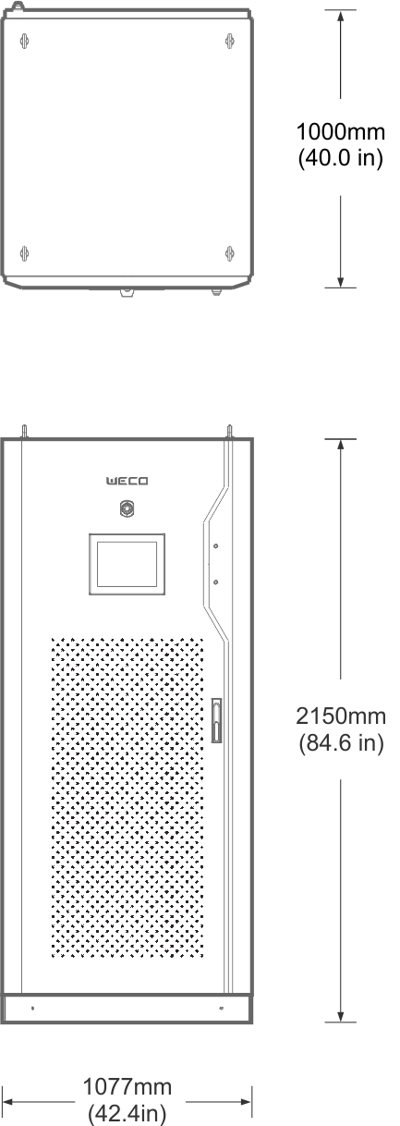
HYBO TL HYBRID
TRANSFORMERLESS HYBRID INVERTER
Specifications
120/120 | 120/180
PV INPUT
PV COMBINER BOX
BATTERY
AC SIDE
BACKUP (Optional)
AC AUXILIARY INPUT
SYSTEM
ENVIRONMENT
INTERFACE
OTHERS
MPPT Max. Voltage Input | 650 V
MPPT Max. Current Input | 200 A
MPPT Max. Power Output | 60 kW x 2 |  | 60 kW x 3
PV Max. Design Power Input | 84 kW x 2 |  | 84 kW x 3
MPPT Input Terminals | 2 x 70 mm² |  | 3x 70 mm²
MPPT Start Up Voltage | 200 V
MPPT Low Voltage Cut Off | 130 V
MPPT Operative Working Range | 200-650 V
MPPT Input Breaker And Capacity | 2 x 250 A | 3 x 250 A
MPPT Input Protection Breaker | Automatic Over Current Protection / 20 kA Interruption Capacity
Combiner Box Strings Inputs Per MPPT | 12 Strings 6 mm² per input
Number Of Combiner Box Per Each HYBO | 2 |  | 3
PV String Max. Current Per Channel | 16 A
Anti Reverse Connection Protection Per Channel | Yes
Max. PV Input Design Power Per Channel | 7000 W
Max. Voltage Input | 650 V
Combiner Output Per MPPT | 70 mm² (1x Positive 1x Negative )
Input String Protection Fuse | 1 x Channel 20 A (Positive Line)
PV Combiner Box IP Rating | IP65
PV Combiner Communication Mode | RS485
Combiner Box Remote Controlled Breaker | 250 A
Remote Emergency Button | Yes (Integrated With The Inverter Emergency Function)
Min. Battery Voltage | 680 V
Min. Number Of Batteries In Series | 15 Battery Modules
Max. Battery Voltage | 1000 V
Max. Number Of Batteries In Series | 17 Battery Modules
Battery Input Channels | 4
Max. Charging / Discharging Power | 120/120 kW | 180/120 kW
Grid Type | 3L + N + GND
Rated Power Output AC Side | 120 kW |  | 120 kW
Rated Current | 172 A |  | 172 A
AC Breakers And Interruption Capacity | 250 A / 50 kA |  | 250 A / 50 kA
Rated Voltage | 400 VAC
Voltage Range | 400 VAC ± 15 %
Rated Frequency (Hz) | 50 Hz / 60 Hz
Frequency Range | ± 3 Hz
Power Factor (Off Grid) | -0.8 ~ +0.8
Frequency Accuracy | 0.2 Hz
Voltage Ripple | < 3 %
Current Ripple | < 2 %
Output Harmonic Wave | < 3 %
Phase Unbalance Load (Off-Grid w/STS Only) | 100%
STS For EPS | Optional Accessory
STS Switch Time On To Off Grid | 20 ms (Linear Load)
STS Switch Time OFF To ON Grid | 30 ms
EPS Overload Support | 0%
EPS Max Power (Only With STS installed) | Support 100% of the Inverter Full Power
EPS Output AC Breaker Interruption Capacity | 250 A / 50 kA |  | 250 A / 50 kA
AC Generator Input Voltage | 400 V 3P + N + GND
AC Input Voltage Range | 400 V +/- 15%
AC Input Voltage Protection Breaker | 250 A / 40 kA |  | 250 A / 40 kA
Reaction Time To External Commands | 200 ms
Switch Time From Charge To Discharge | 20 ms
Switch Time From Discharge To Charge | 20 ms
Operation Mode PV + Grid Only (No Battery) | Supported
System Start Up Capability ON Grid (No Battery) | PV + Grid = Operation Granted
System Start Up Capability OFF Grid | Battery Only = Operation Granted
Emergency Stop Intervention | 600 ms
IP rating | IP20
Working Temperature | -20 °C ~ 55 °C (Derating T > 45 °C)
Humidity | 0 % RH ~ 95 % RH, Non-condensing
Working Altitude | T < 45 °C: 2000 m (No Derating), 2000 m ~ 4000 m Derating
Noise | < 75 dB
Communication | RS485, CAN, Wi-Fi ( SUNSPEC )
Protocol | CAN, ModBus TCP/IP
Installation | Indoor In Controlled Temperature Room
Maximum Efficiency | 97%
Isolation | Transformer-less
Protection Class | Class I
Cooling Type | Forced Air
Dimensions (W x D x H) (mm) | 1077 x 1000 x 2150
Weight | 570 kg |  | 600 kg
wecobatteries.com
We recommend contacting WeCo for the most up-to-date datasheet, read warranty and manual before making any purchasing decisions.
No part of this document can be copied or reproduced without WeCo written permission.
All data is subject to change without prior notice.
Notes:
Cell height 0.32

Slide 5
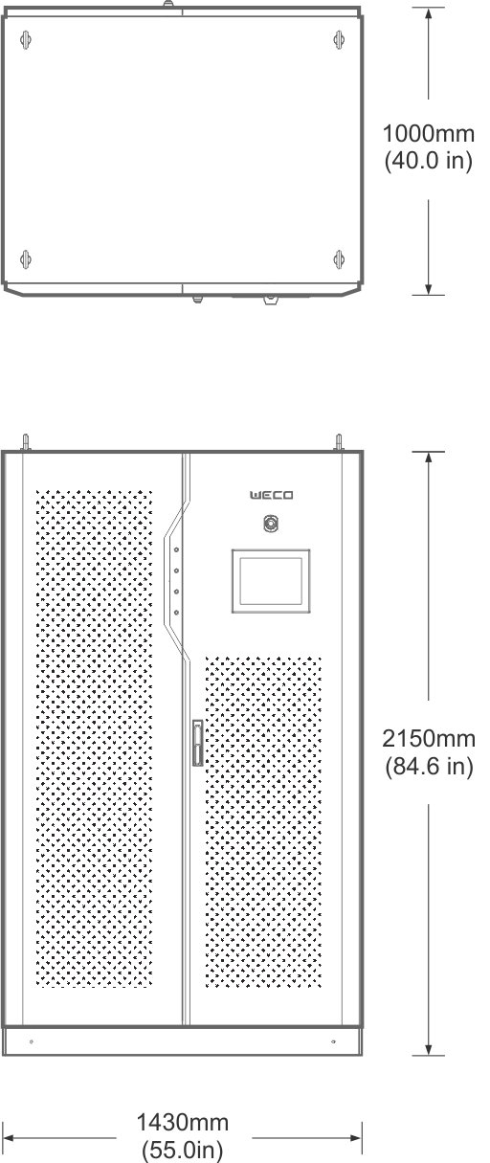
HYBO TL HYBRID
TRANSFORMERLESS HYBRID INVERTER
Specifications
180/120 | 180/180 | 180/240 | 240/180 | 240/240
PV INPUT
PV COMBINER BOX
BATTERY
AC SIDE
BACKUP EPS (OPTIONAL)
AC AUXILIARY INPUT
SYSTEM
ENVIRONMENT
INTERFACE
OTHERS
MPPT Max. Voltage Input | 650 V
MPPT Max. Current Input | 200 A
MPPT Max. Power Output | 60 kW x 2 | 60 kW x 3 |  | 60 kW x 3 | 60 kW x 4 | 60 kW x 4
PV Max. Design Power Input | 84 kW x 2 | 84 kW x 3 |  | 84 kW x 3 | 84 kW x 4 | 84 kW x 4
MPPT Input Terminals | 2*70 mm² | 3x 70 mm² |  | 3x 70 mm² | 4x 70 mm² | 4x 70 mm²
MPPT Start Up Voltage | 200 V
MPPT Low Voltage Cut Off | 130 V
MPPT Operative Working Range | 200-650 V
MPPT Input Breaker And Capacity | 2 x 250 A | 3 x 250 A |  | 4 x 250 A | 3 x 250 A | 4 x250 A
MPPT Input Protection Breaker | Automatic Over Current Protection / 20 kA Interruption Capacity
Combiner Box Strings Inputs Per MPPT | 12 Strings 6 mm² per input
Number Of Combiner Box Per Each HYBO | 2 | 3 |  | 4 | 3 | 4
PV String Max. Current Per Channel | 16 A
Anti Reverse Connection Protection Per Channel | Yes
Max. PV Input Design Power Per Channel | 7000 W
Max. Voltage Input | 680 V
Combiner Output Per MPPT | 70 mm² (1x Positive 1x Negative )
Input String Protection Fuse | 1 x Channel 20 A (Positive Line)
PV Combiner Box IP Rating | IP65
PV Combiner Communication Mode | RS485
Combiner Box Remote Controlled Breaker | 250 A
Remote Shut Down | Yes (Integrated With The Inverter Emergency Function)
Min. Battery Voltage | 680 V
Min. Number Of Batteries In Series | 15 Battery Modules
Max. Battery Voltage | 1000 V
Max. Number Of Batteries In Series | 17 Battery Modules
Battery Input Channels | 4
Max. Charging / Discharging Power | 180/180 kW | 180/180 kW | 240 kW/180 kW |  | 240 kW/240 kW | 240 kW/240 kW
Grid Type | 3L + N + GND
Rated Power Output AC Side | 180 kW | 180 kW |  | 180 kW | 240 kW | 240 kW
Rated Current | 258 A | 258 A |  | 258 A | 344 A | 344 A
AC Breakers And Interruption Capacity | 315 A / 70 kA | 315 A / 70 kA |  | 315 A / 70 kA | 400 A / 70 kA | 400 A / 70 kA
Rated Voltage | 400 Vac
Voltage Range | 400 Vac ± 15 %
Rated Frequency (Hz) | 50 Hz / 60 Hz
Frequency Range | ± 3 Hz
Power Factor (Off Grid) | -0.8 ~ +0.8
Frequency Accuracy | 0.2 Hz
Voltage Ripple | < 3 %
Current Ripple | < 2 %
Output Harmonic Wave | < 3 %
Phase Unbalance Load (Off-grid With STS Only) | 100%
STS For EPS | Optional
STS Switch Time On To Off Grid | 20 ms (Linear Load)
STS Switch Time OFF To ON Grid | 30 ms
EPS Overload Support | 0%
EPS Max Power (Only With STS Installed) | 100%
EPS Output AC Breaker Interruption Capacity | 315 A / 70 kA | 315 A / 70 kA |  | 315 A / 70 kA | 400 A / 70 kA | 400 A / 70 kA
AC Generator Input Voltage | 400 V 3P + N + GND
AC Input Voltage Range | 400 V +/- 15%
AC Input Voltage Protection Breaker | 315 A / 70 kA | 315 A / 70 kA |  | 315 A / 70 kA | 400 A / 70 kA | 400 A / 70 kA
Reaction Time To External Commands | 200 ms
Switch Time From Charge To Discharge | 20 ms
Switch Time From Discharge To Charge | 20 ms
Operation Mode PV + Grid Only (No Battery) | Supported
System Start Up Capability ON Grid (No Battery) | PV + Grid = Operation Granted
System Start Up Capability OFF Grid | Battery Only = Operation Granted
Emergency Stop Intervention | 600 ms
IP rating | IP20
Working Temperature | -20 °C ~ +55 °C (Derating T > 45 °C)
Humidity | 0 % RH ~ 95 % RH, Non-condensing
Working Altitude | T < 45 °C: 2000 m (No Derating), 2000 m ~ 4000 m Derating
Noise | < 75 dB
Communication | RS485, CAN, Wi-Fi ( SUNSPEC )
Protocol | CAN, ModBus TCP/IP
Installation | Indoor In Controlled Temperature Room
Maximum Efficiency | 97%
Isolation | Transformer-less
Protection Class | Class I
Cooling Type | Forced Air
Dimensions (W x D x H) (mm) | 1430 x 1000 x 2150
Weight | 720 kg | 750 kg |  | 780 kg | 780 kg | 0 kg
We recommend contacting WeCo for the most up-to-date datasheet, read warranty and manual before making any purchasing decisions.
No part of this document can be copied or reproduced without WeCo written permission.
All data is subject to change without prior notice
wecobatteries.com
Notes:
Cell height 0.32

Slide 6
HYBO CS
Transformer based Hybrid Inverter
Specifications
100 + MPPT | 150 + MPPT | 250 + MPPT | 500 + MPPT
PV INPUT | MPPT Max. Voltage Input | 650 V
 | MPPT Max. Power Output | 120/180/240kW | 120/180/240kW | 300/360kW | 600/660/720kW | 600/660/720kW
 | Number Of MPPT | 2/3/4 | 2/3/4 | 5/6 | 10/11/12 | 10/11/12
 | MPPT Max. Current Input | 200 A
 | PV Max. Design Power Input | 84 kW each
 | MPPT Max. Power Output | 60 kW each
 | MPPT Input Terminals | 70 mm each
 | MPPT Start Up Voltage | 250 V
 | MPPT Low Voltage Cut Off | 150 V
 | MPPT Operative Working Range | 250-650 V
 | MPPT Input Breaker And Capacity | 250 A / 20 kA---Each
PV COMBINER BOX | MPPT Input Protection Breaker | Automatic Over Current Protection / 16 kA Interruption Capacity
 | Combiner Box Strings Inputs Per MPPT | 12 Strings Inputs 12 mm each MPPT
 | Combiner Box Output Cables | 70 mm each MPPT
 | Numbers Of Combiners Per Each HYBO | 2/3/4 | 2/3/4 | 5/6 | 10/11/12
 | PV String Max. Current Per Channel | 18A
 | Max. PV Input Design Power Per Channel | 7000 W
 | Max. Voltage Input | 680 V
 | String Output To Inverter | 1 x 70 mm²
 | String Protection Fuse | 1 x Channel 20 A
 | PV Combiner Box IP Rating | IP65
 | PV Combiner Communication Mode | RS485
 | Combiner Box Remote Controlled Breaker | 250 A
 | Remote Emergency Button | Yes
BATTERY | Min. Battery Voltage | 420 V |  |  | 500 V | 500 V
 | Min. Number Of Batteries In Series | 10 |  |  | 11 | 11
 | Max. Battery Voltage | 850 V
 | Max. Number Of Batteries In Series | 15 Battery Modules
 | Battery Input Channels | 2 |  |  | 3 | 3
 | Max. Charging | 120/180/240 kW | 120/180/240 kW | 300/360 kW | 600/660/720 kW | 600/660/720 kW
AC SIDE | Max. Discharging Power | 100 kW | 150 kW | 250 kW | 500 kW | 500 kW
 | Grid Type | 3L + N + GND
 | Rated Power Output AC Side | 100 kW | 150 kW | 250 kW | 500 kW | 500 kW
 | Rated Current | 144 A | 216 A | 361 A | 722 A | 722 A
 | AC Breakers And Interruption Capacity | 200 A/25 kA | 250 A /25 kA | 600 A/35 kA | 1250 A/50 kA | 1250 A/50 kA
 | Rated Voltage | 400 VAC
 | Voltage Range | 400 VAC ± 15 %
 | Rated Frequency (Hz) | 50 Hz / 60 Hz
 | Frequency Range | ± 3 Hz
 | Power Factor (Off-Grid) | -1 ~ +1
 | Frequency Accuracy | 0.2 Hz
 | Voltage Ripple | < 3 %
 | Current Ripple | < 2 %
BACKUP (OPTIONAL) | Output Harmonic Wave | < 3 %
 | Phase Unbalance Load (Off-Grid w/STS Only) | 100%
 | STS For EPS | Optional Accessory
 | STS Switch Time ON To Off Grid | 20 ms (Linear Load)
 | STS Switch Time OFF To ON Grid | 30 ms
 | EPS Overload Support | 110% Continuous
 | EPS Max. Power (Only With STS Installed) | 100%
 | EPS Output AC Breaker Interruption Capacity | 200 A / 25 kA | 250 A / 25 kA | 600 A / 35 kA | 1250 A / 50 kA | 1250 A / 50 kA
 | AC Generator Input Voltage (*) | 400 V 3P + N + GND
AC AUXILIARY INPUT | AC Input Voltage Range | 400 V +/- 15%
 | AC Input Voltage Protection Breaker | 200 A / 25 kA | 250 A / 25 kA | 600 A / 35 kA | 1250 A / 50 kA | 1250 A / 50 kA
 | Reaction Time To External Commands | 200 ms
SYSTEM | Switch Time From Charge To Discharge | 20 ms
 | Switch Time From Discharge To Charge | 20 ms
 | Operation Mode PV + Grid Only (No Battery) | Not Supported
 | System Start Capability Off-Grid | Battery = Operation Granted
 | Emergency Stop Intervention | 600 ms
 | IP Rating | IP20
 | Working Temperature | -20 °C ~ +60 °C (Over 50 °C Derating)
ENVIRONMENT | Relatively Humidity | 0 % RH ~ 95 % RH, Non-condensing
 | Working Altitude | At 45 °C, 2000 m (No Derating), 2000 m ~ 4000 m Derating
 | Noise | < 70 dB
INTERFACE | Communication | RS485, CAN, Wi-Fi ( SUNSPEC )
 | Protocol | CAN, ModBus TCP, ModBus RTU
OTHER | Installation | Indoor, In Controlled Temperature Room
 | Maximum Efficiency | 97%
 | Isolation | Transformer-less
 | Protection Class | Class I
 | Cooling Type | Forced Air
 | Dimensions (W x D x H) (mm) | 1200 x 800 x 2050 | 1200 x 800 x 2050 | 600 x 720 x 2050 + 1200 x 800 x 2050 | 600 x D720 x 2050 + 1600 x 1050 x 2050 | 600 x D720 x 2050 + 1600 x 1050 x 2050
 | Weight | 1120/1150/1180 kg | 1250/1280/1310 kg | 1980/2010 kg | 3265/3295/3325 kg | 3265/3295/3325 kg
(*) The cabinet has one AC input interface only; to connect both the generator and the grid please install an external ATS
wecobatteries.com
We recommend contacting WeCo for the most up-to-date datasheet, read warranty and manual before making any purchasing decisions.
No part of this document can be copied or reproduced without WeCo written permission.
All data is subject to change without prior notice.
Notes:
Cell height 0.32

Slide 7
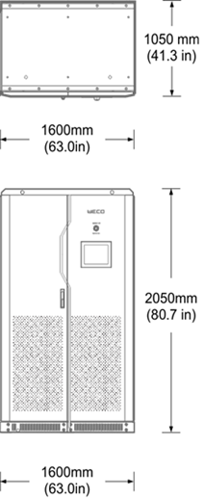
HYBO TS
Transformer based PCS Inverter
Specifications | 100 | 150 | 250 | 500
BATTERY
AC SIDE
BACKUP EPS (OPTIONAL)
SYSTEM
ENVIRONMENT
INTERFACE
OTHERS
STANDARDS
Min. Battery Voltage | 450 V |  |  | 500 V
Min. Number Of Batteries In Series | 10 |  |  | 11
Max. Battery Voltage | 850 V
Max. Number Of Batteries In Series | 15 Battery Modules
Battery Input Channels | 1
Max. Charging Current | 270 A | 405 A | 670 A | 1120 A
Max. Charging / Discharging Power | 100 kW | 150 kW | 250 kW | 500 kW
Grid Type | 3L + N + GND
Rated Power Output AC Side | 100 kW | 150 kW | 250 kW | 500 kW
Rated Current | 145 A | 215 A | 360 A | 720 A
AC Breakers And Interruption Capacity | 200 A/25 kA | 250 A /25 kA | 600 A/35 kA | 1250 A/50 kA
Rated Voltage | 400 Vac
Voltage Range | 400 Vac ± 15 %
Rated Frequency (Hz) | 50 Hz / 60 Hz
Frequency Range | ± 3 Hz
Power Factor (Off Grid) | -1~ +1
Frequency Accuracy | 0.2 Hz
Voltage Ripple | < 3 %
Current Ripple | < 2 %
Output Harmonic Wave | < 3 %
Phase Unbalance Load (Off-Grid With STS Only) | 100%
STS For EPS | Built In
STS Switch Time ON To Off Grid | 20 ms (Linear Load)
STS Switch Time OFF To ON Grid | 30 ms
EPS Overload Support | 110%
EPS Critical Load Support | EPS output ports can be paralleled between inverters (max. 4 inverters in parallel)
EPS Output AC Breaker Interruption Capacity | 200 A/25 kA | 250 A /25 kA | 600 A/35 kA | 1250 A/50 kA
Reaction Time To External Commands | 200 ms
Switch Time From Charge To Discharge | 20 ms
Switch Time From Discharge To Charge | 20 ms
System Start Capability OFF Grid | OFF Grid + Battery = Operation Granted
Emergency Stop Intervention | 600 ms
IP Rating | IP20
Working Temperature | -20 °C ~ +55 °C (Over 45 °C Derating)
Humidity | 0 % RH ~ 95 % RH, Non-condensing
Working Altitude | At 45 °C, 2000 m (No Derating), 2000 m ~ 4000m Derating
Noise | < 70 dB
Communication | RS485, CAN, Wi-Fi (SUNSPEC)
Protocol | CAN, ModBus TCP, ModBus RTU
Installation | Indoor In Controlled Temperature Room
Maximum Efficiency | 97%
Isolation | Isolation Transformer (Built-In)
Protection Class | Class I
Cooling Type | Forced Air
Dimensions (W x D x H) (mm) | 800 x 800 x 2050 | 800 x 800 x 2050 | 1200 x 800 x 2050 | 1600 x 1050 x 2050
IEC And Grid Codes | CE LVD EN62109-1/-2, EN62447-1, EN61000-6-2, EN61000-6-4, CGC NSR097 (South Africa)
We recommend contacting WeCo for the most up-to-date datasheet, read warranty and manual before making any purchasing decisions.
No part of this document can be copied or reproduced without WeCo written permission.
All data is subject to change without prior notice
wecobatteries.com
Notes:
Cell height 0.32

Slide 8
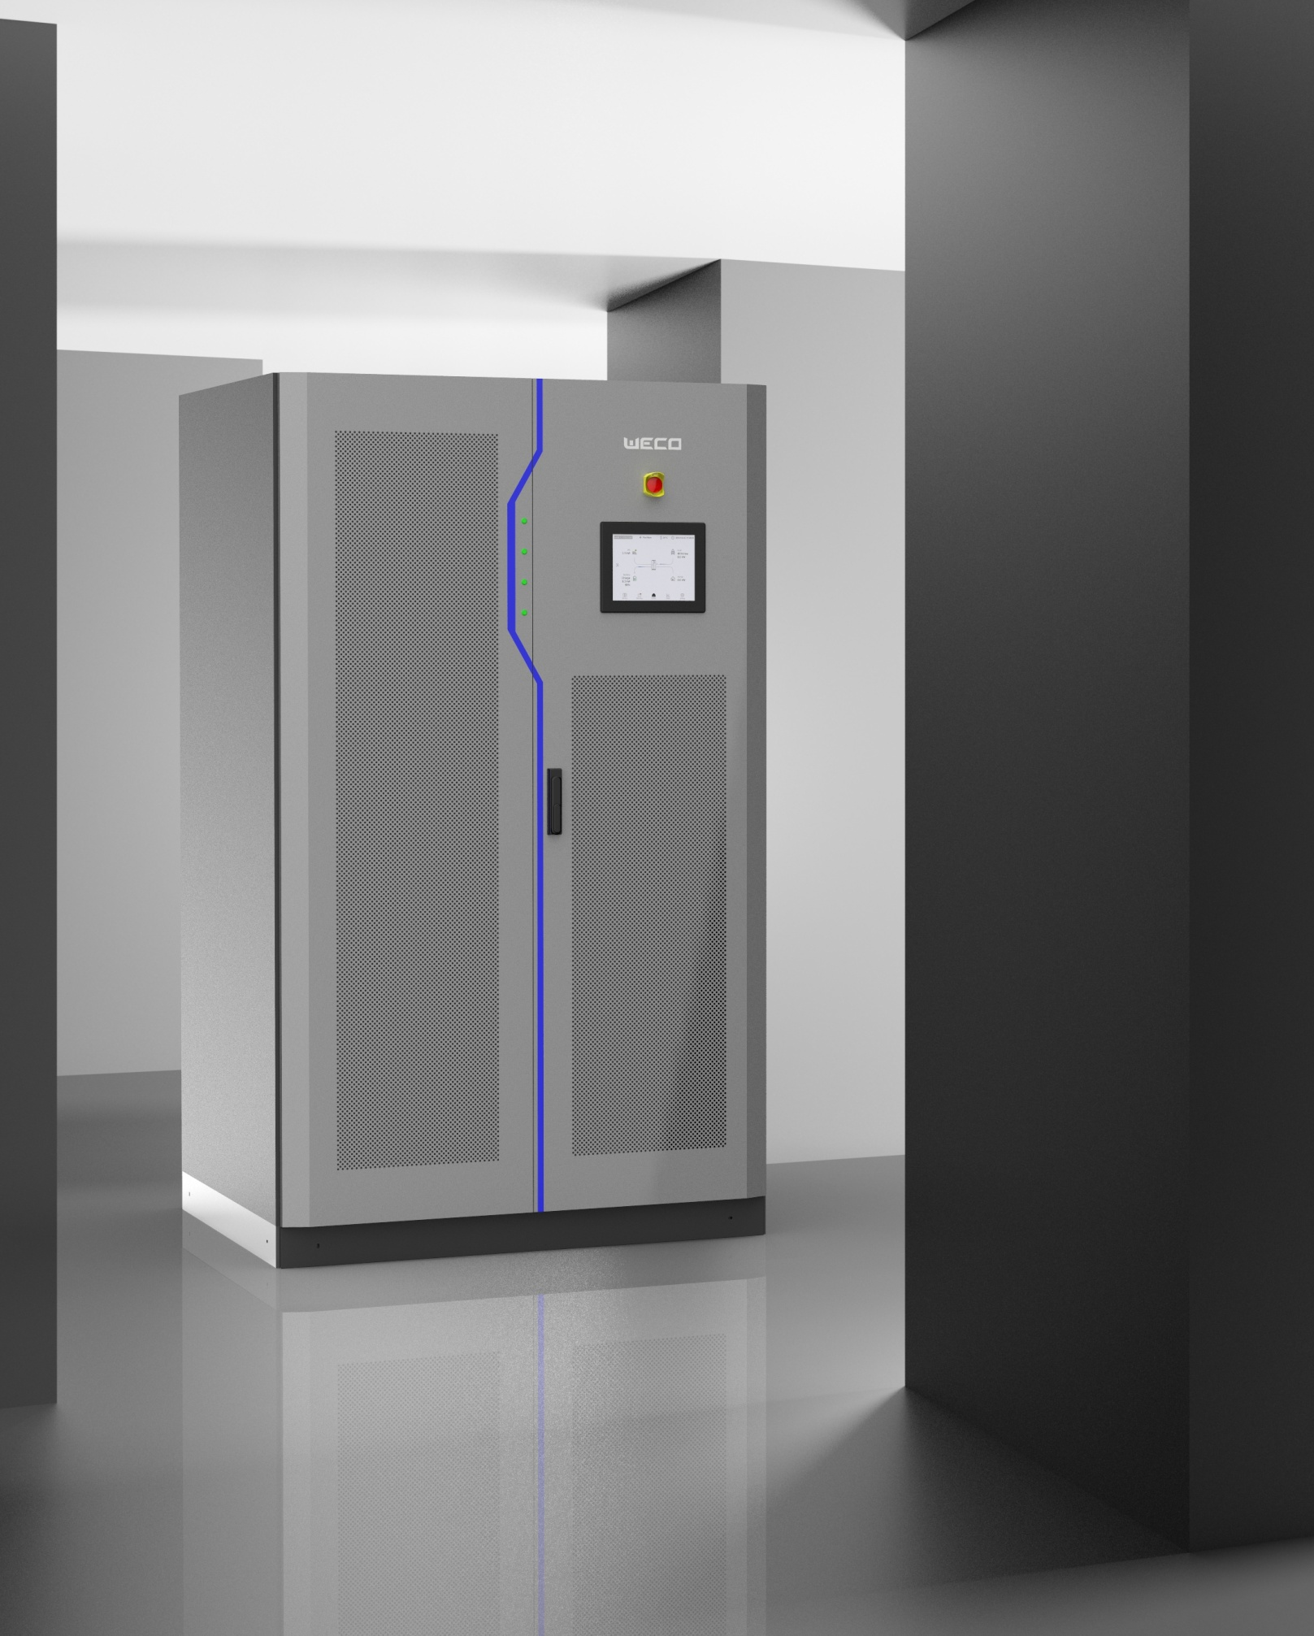
The Next Generation BESS INVERTER is here and it’s WeCo.
Hybo Hybrid Indoor Inverters encompass economic, environmental, and operational benefits, making them a compelling choice for those seeking a sustainable and reliable energy solution for indoor spaces.
WeCo Srl a Socio Unico
Viale J. F. Kennedy 113-121
50038 Scarperia e San Piero
Firenze, Italy
weco@wecobatteries.com
www.wecobatteries.com
Images herein are for demonstration only and may not reflect final product outlook. Confirm current data with WeCo before purchase. Unauthorized use, copying, or reproduction of design, logo, or content is prohibited. WeCo is a registered brand of WeCo Srl Italia

